Slide 1
BABEŞ-BOLYAI UNIVERSITY CLUJ-NAPOCA FACULTY OF MATHEMATICS AND COMPUTER SCIENCE SPECIALIZATION COMPUTER SCIENCE
Creating a Web Application using ASP.NET (Core MVC)
Supervisor
Assoc. Prof. Dr. Andreea Vescan
Graduate
Purdea Bogdan-Florin
2018

Slide 2
Contents of the thesis
Defining a web application
ASP.NET Application Life Cycle
Development of the application
Conclusions

Slide 3
What is a web application?
A web application is any computer program that performs tasks using a web browser as its client
Has a client-server environment
The client application is used to enter the information
The server application is used to store the information

Slide 4
Stages of the ASP.NET application life cycle
A user requests an application resource from the Web server
ASP.NET receives the first request for the application
ASP.NET core objects are created for each request
An object is assigned to the request
The request is processed by the assigned objects pipeline

Slide 5
Technologies used for developing the application
Visual Studio 2017
Entity Framework Core
ASP.NET Core MVC

Slide 6
The components of the application
The data access layer
The RESTful service
The user interface

Slide 7
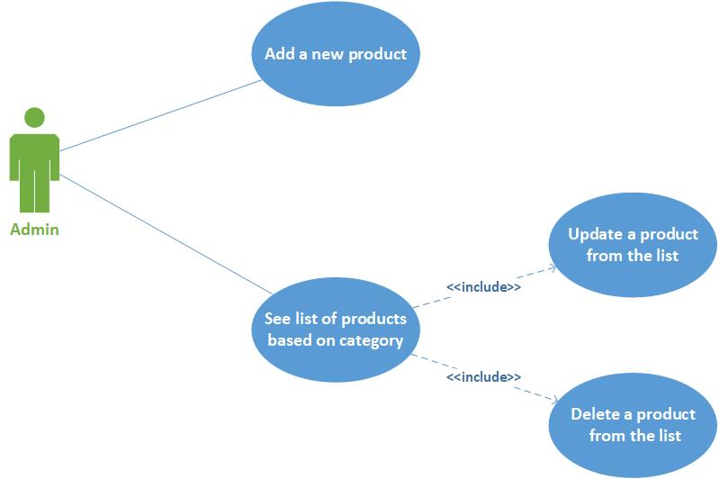
Application functionalities for administrator

Slide 8
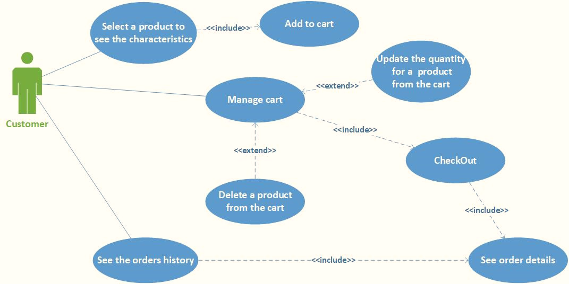
Application functionalities for customer

Slide 9
Conclusions
ASP.NET Core MVC is a good and reliable framework for building web applications and web APIs
The MVC design pattern provides a clean separation of concerns

